Slide 1

Fashion Product Recommender using Generative AI

Slide 2
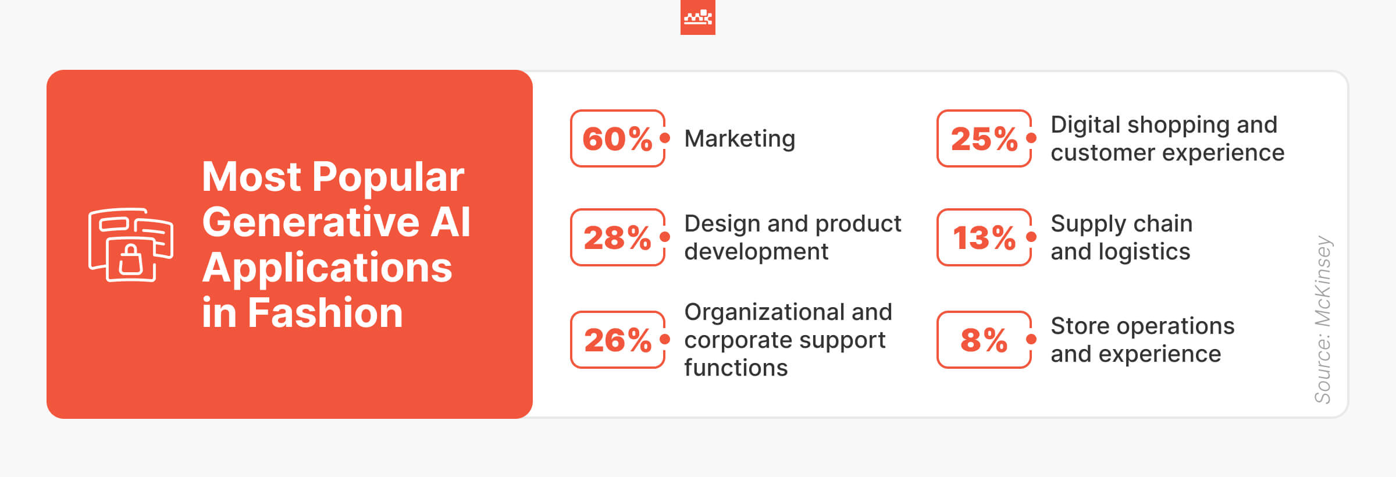













GENERATIVE AI & Fashion Industry
Generative AI applications across multiple formats
Text
Automatically create a product description once a SKU enters system
Images & Video Generation
Tailor virtual product try-on and demos to individual consumers (clothing try-on, styling recommendations).
Audio
Make in-line suggestions for inclusive language, voice; tone, and correct terminology in all content.
Overall Benefits
Chatbots
Enhance intelligent AI agents and self-service to address advanced consumer inquiries
Improve Efficiency
Decrease in Costs
Task Automation
Better User Engagement
Search
Generation of Synthetic Data
Cross Platform Channels
Improved Decision Making
Security & Compliances
Enhanced search functions using natural language processing and machine learning

Slide 3
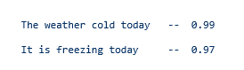
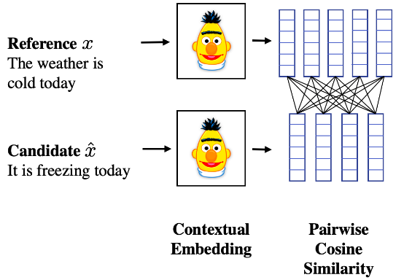
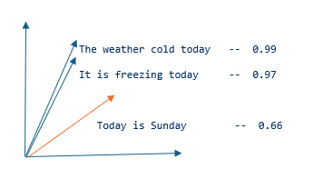
TEXT SIMILARITY
What is Text Similarity?
Text similarity measures the degree of resemblance or agreement between two or more texts.
Methods:
Cosine similarity is a measure that calculates the cosine of the angle between
two vectors, providing a numerical value indicating how similar they are in
direction regardless of their magnitudes
nltk (Natural Language Toolkit)m scikit-learn,Spacy:
from sentence_transformers import SentenceTransformer
model = SentenceTransformer('sentence-transformers/all-MiniLM-L6-v2')
sentences = [
"The weather cold today",
"It is freezing today"
]
embeddings = model.encode(sentences)
SECURITY
Notes:
validate tools madhavi

Slide 4
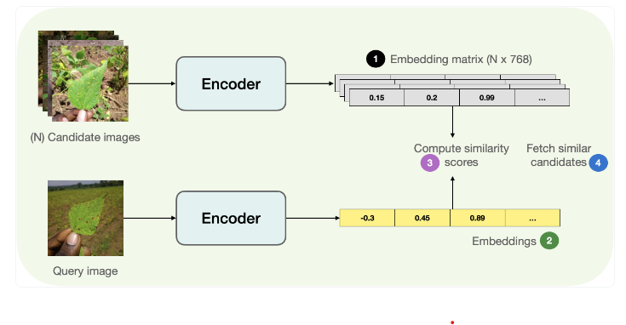


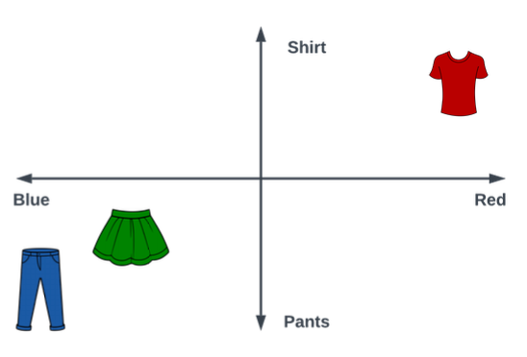
IMAGE SIMILARITY
What is Image Similarity?
Image Similarity in the context of GenAI refers to the comparison of
visual content to determine how similar or dissimilar two images are.
Methods:
The high-dimensional pixel space of images (e.g., 224 x 224 x 3) into a
lower-dimensional vector (e.g., 768 dimensions).
Cosine similarity measures the cosine of the angle between
two Images projected in a multi-dimensional space
Python Packages for Image Similarity:
Hugging Face
SECURITY

Slide 5
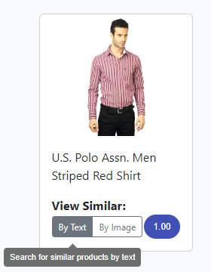
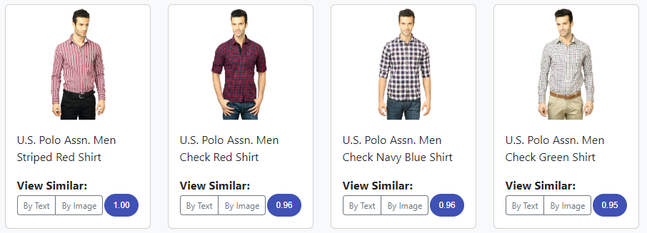
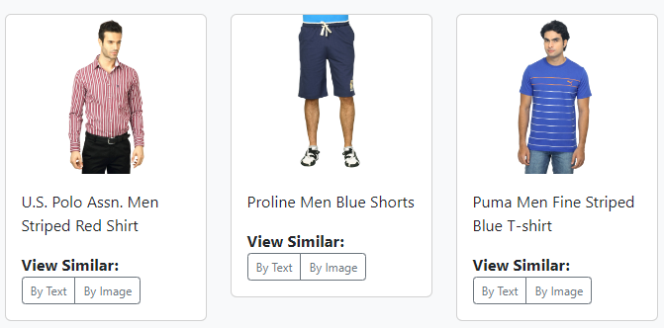
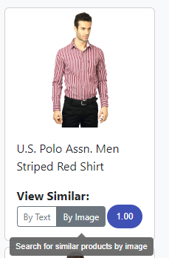
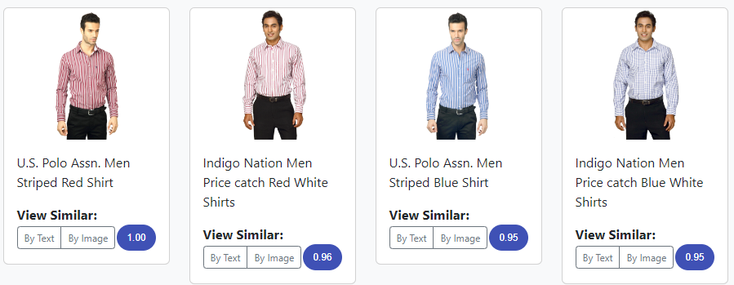
GenAI Product Catalog - Similar/Visual Search
Given a query image, find the Top K most "visually" similar in the catalogue
View similar products by Image
Potentially expand the number of models per product

Slide 6
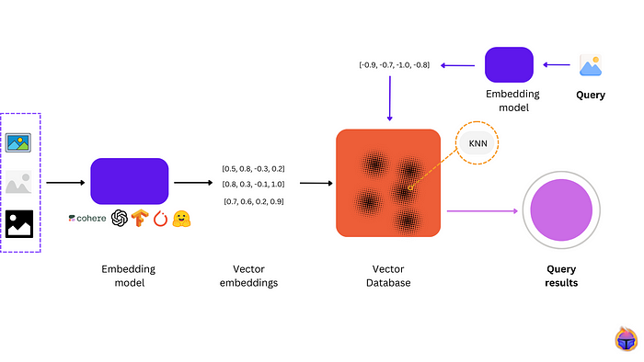
Implementation
SECURITY
Notes:
validate tools madhavi

Slide 7
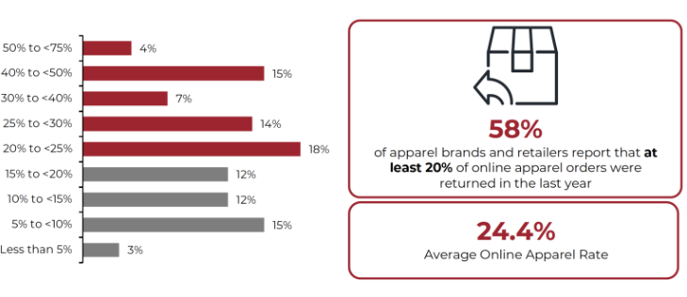

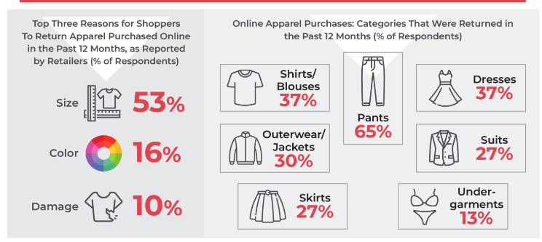
Adopting GenAI Technology To Reduce Returns in Online Apparel Shopping
Percentage of Online Apparel Orders Returned in the Last 12 Months (% of Respondents)
OVERVIEW
The high return rate is a growing issue for apparel brands and retailers, substantially impacting revenues and costs, customer satisfaction and loyalty, as well as sustainability.
The average return rate of online apparel orders in the US is 24.4%, Based on estimate of a total $155.8 billion online apparel and footwear market in 2023, a 24.4% return rate would translate to $38 billion in returns, with an estimated $25.1 billion in processing costs in 2023. These alarming numbers indicate the need for retailers to implement loss-minimization solutions.*
The top 2 reasons are-
Size/fit (53% of respondents)
Color (16%)
Incorrect sizing is the top reason for online apparel returns.
OVERVIEW
Online Orders: Reasons for Apparel Returns in the Last 12
* https://coresight.com/research/the-true-cost-of-apparel-returns-alarming-return-rates-require-loss-minimization-solutions/
Notes:
NICE

Slide 8
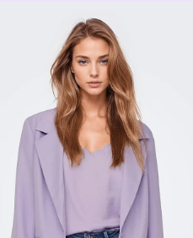
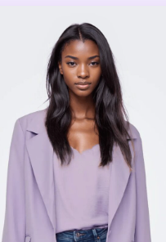
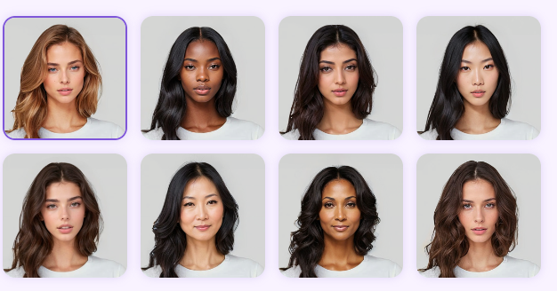
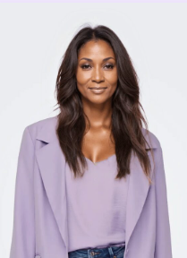
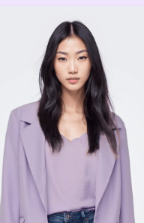
Diversified Gen AI-generated model gallery
To enable fashion retailers cut photo production costs and the option to choose specific characteristics such as body type, complexion, hairstyle, age, and more using Diversified AI-generated model gallery
Based on Body Shape Analysis and user input , app delivers precise body type assessments and fashion recommendations that empower users to feel confident and validated in their fashion choices.
You are eyeing onto models of body and skin types that roughly match your own, thus making the product easier to visualize.
.

Slide 9
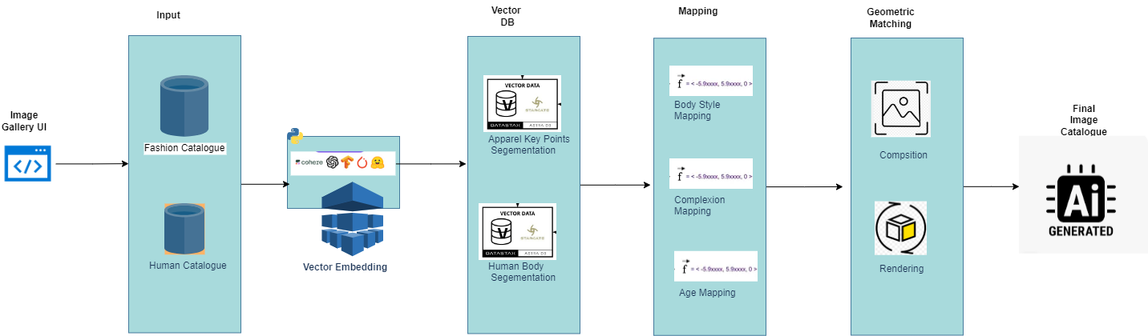
Design & Architecture
SECURITY
Notes:
validate tools madhavi

Slide 10
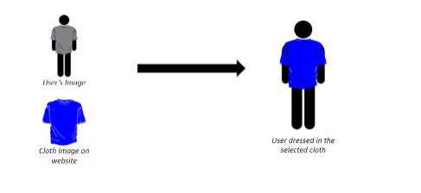
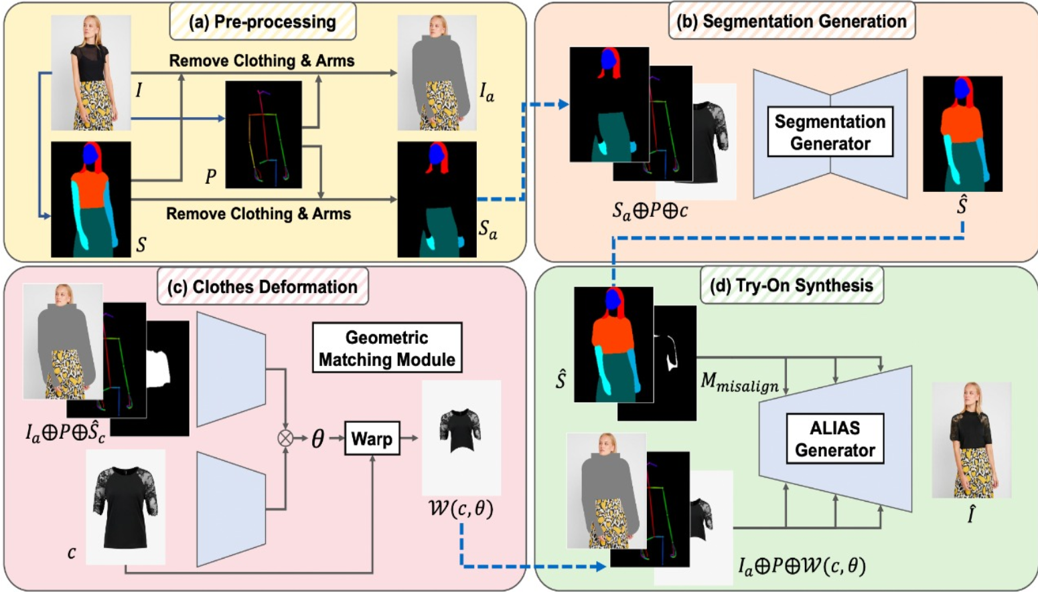
Methodology
SECURITY
Notes:
validate tools madhavi

Slide 11
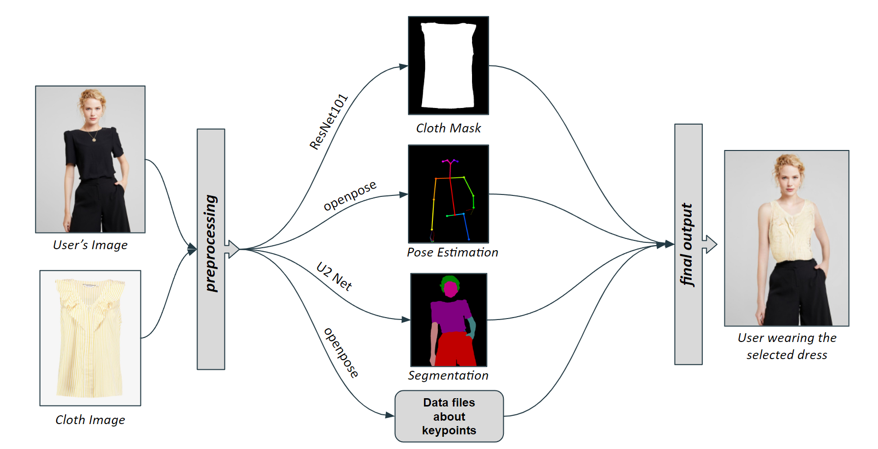
Block Diagram
SECURITY
Notes:
validate tools madhavi

Slide 12
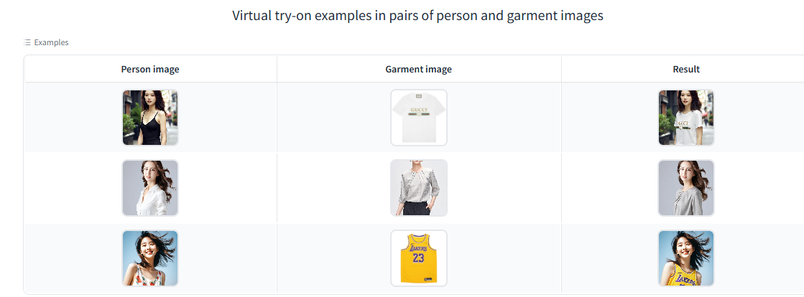
Demo
SECURITY
Notes:
validate tools madhavi

Slide 13
Technology Stack
Python
NoSQL - AstraDB
Data Fabric- Databricks
Vector Embedding -https://huggingface.co/

Slide 14
Responsible AI principles
Transparency: Clearly communicate how the AI models work, how data is used, and how recommendations are generated.
Fairness and Inclusivity: Ensure the AI models are trained on diverse datasets representing various body types, skin tones, ages, and other characteristics to avoid biases and ensure recommendations are inclusive.
Privacy and Security: Protect user data by implementing robust privacy measures. Ensure that user information is anonymized, securely stored, and not shared without consent.
User Control: Give users control over their data and the ability to opt-out or delete their information..
Accountability: Establish clear accountability for the AI system's decisions and outcomes. Provide channels for users to report issues or biases
Ethical Use: Ensure the AI application is used ethically, promoting positive body image and self-confidence. Avoid perpetuating harmful stereotypes or unrealistic beauty standards.

Slide 15
Generative AI Innovation Hub
Python driver to connect to Generative AI database
Create Vector Embedding
Python Code to Load a set of vector embeddings
Cassandra CQL Code to Load a set of vector embeddings
Vector Embeddings in Image and Text Similarity
Perform a similarity search to find vectors that are close to the one in your query.
Building a Similarity Search Engine using
Cosine Similarity
Euclidean Similarity
Dot-Product Similarity

Slide 16
TaskLance Analytics is part of Authtics Technology Solutions LLP (LLP AAX-3774)

